Slide 1
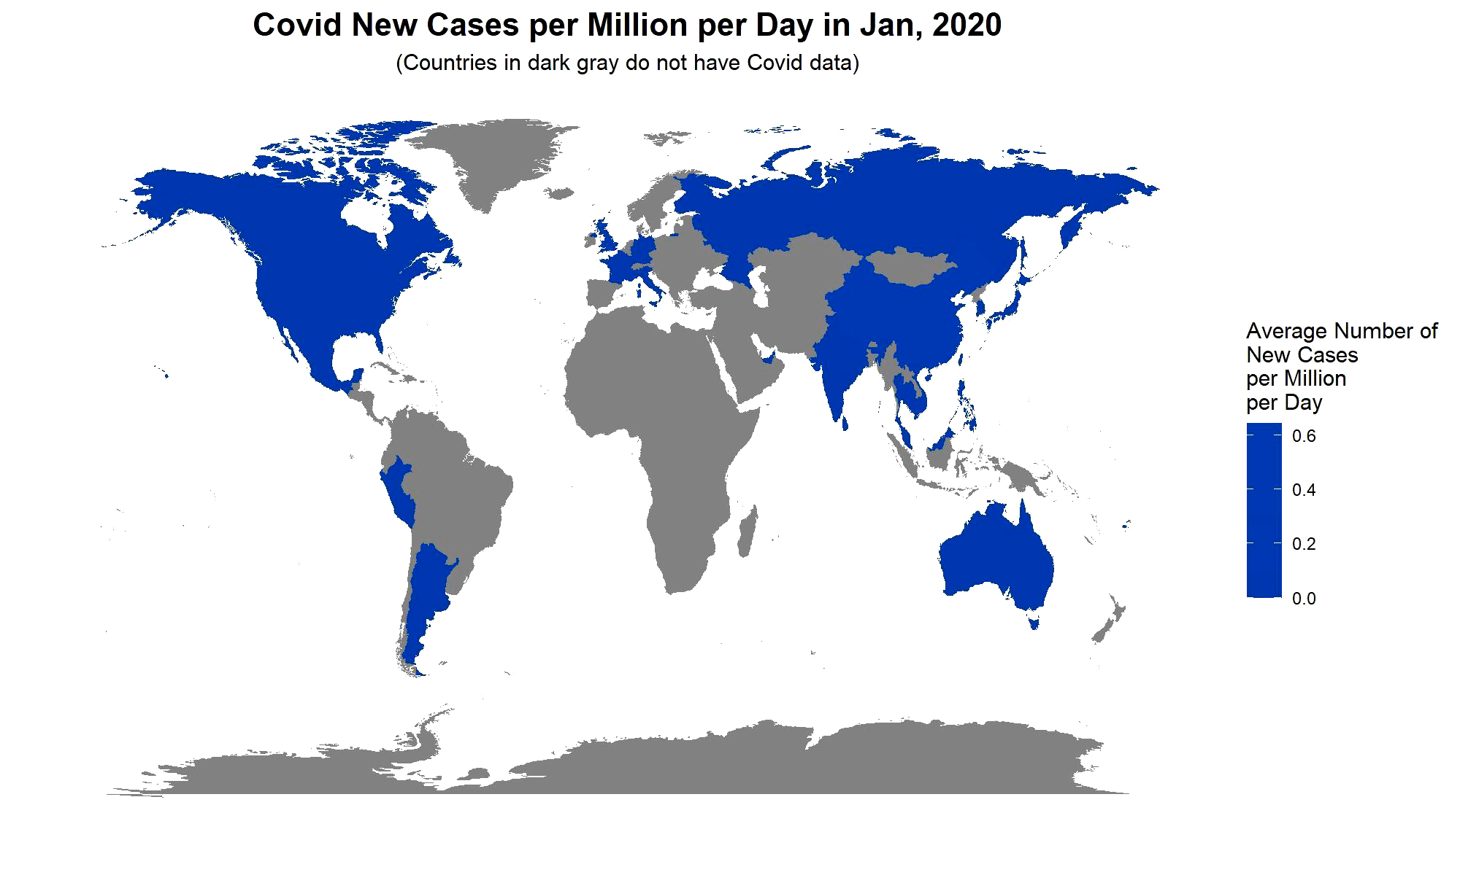
Part I The Covid Situation Since January 2020

Slide 2
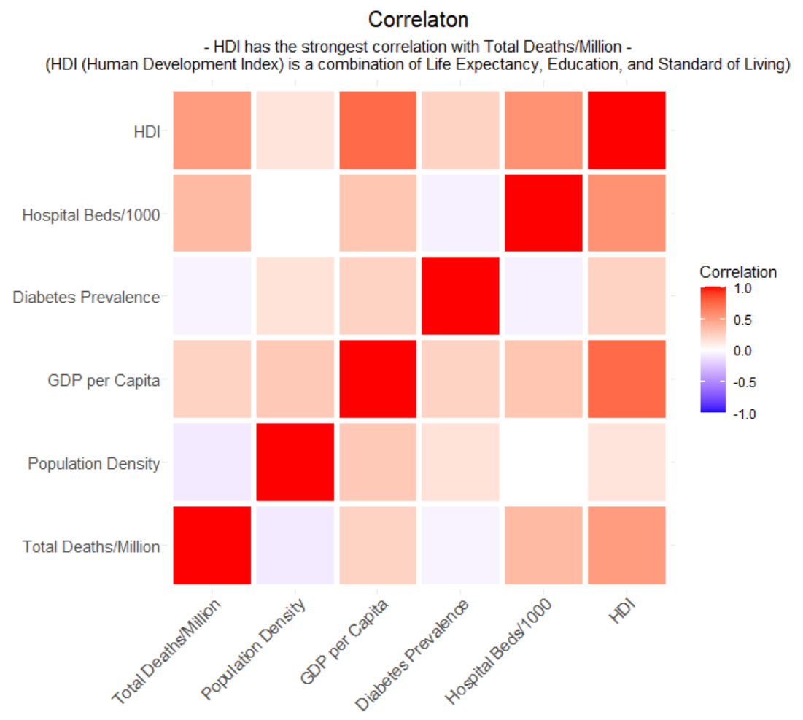
Part II What is Related to Total Deaths per Million?

Slide 3

Part III How is HDI related to Total Deaths per Million?

